Slide 1

People Management
Community of Practice
Notes:
A smart project manager understands the critical value of:
managing stakeholders and cultivating positive working relationships amongst team members;
recruiting and training the right people at the right time and sometimes even in the right place;
and managing people's communications so that everyone is on the same page thereby understanding and continually contributing to the progress of a
How to manage stakeholders :
expectations and interests,
training needs
project contributions,
and project communications.

Slide 2

People Management
Stakeholder Management
Communication Management Plan
Human Resource Management Plan

Slide 3

Quick update on stakeholder management
https://www.youtube.com/watch?v=w5hSzxG6u-4

Slide 4
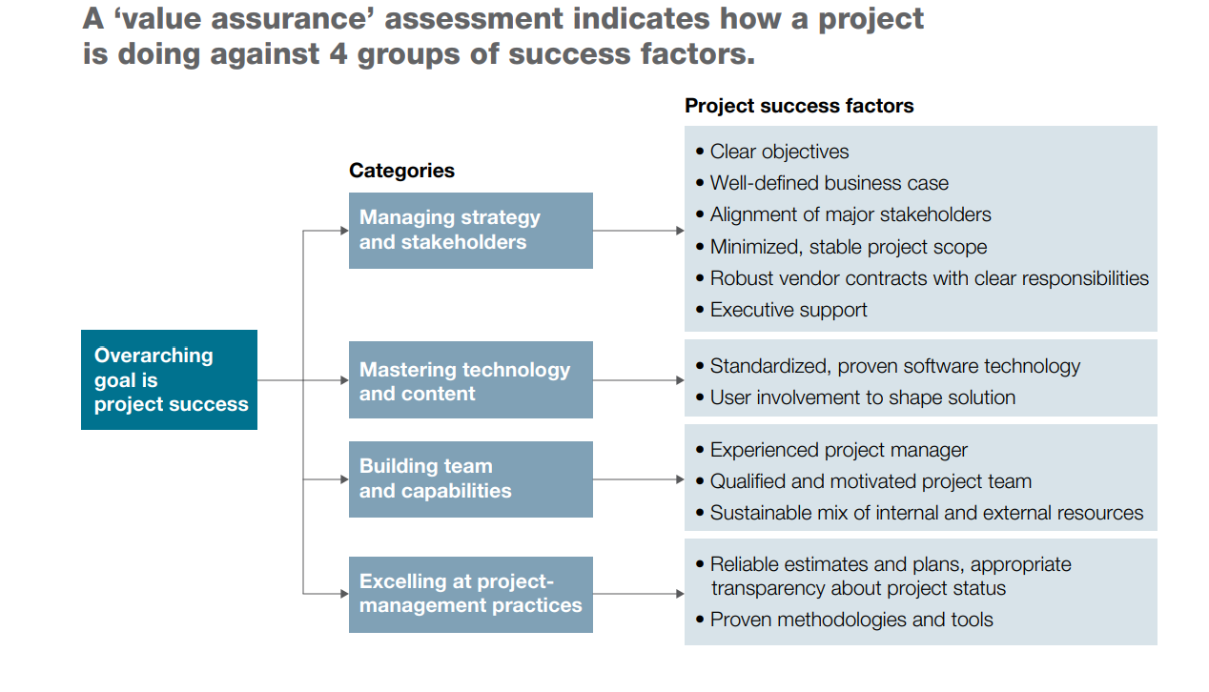
McKinsey Survey on - Delivering large-scale IT projects on time budget and value.
Notes:
Reference : https://www.berendt-partner.de/wp-content/uploads/2014/11/MOBT_27_Delivering_large-scale_IT_projects_on_time_budget_and_value.pdf

Slide 5

Process of stakeholder analysis – 4 steps
Identifying the stakeholders
Clarifying the interest and influence of stakeholders
Agreeing on the process of engagement between stakeholders, &
Managing the relationship with stakeholders.

Slide 6


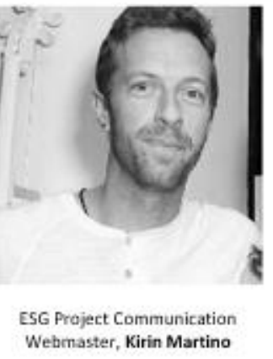




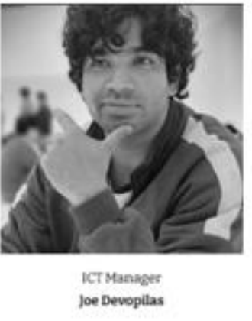
Step 1 - Identify your stakeholders
Notes:
The project sponsor, or executive sponsor, is a person or a group of people at the senior management level. They are responsible for the success of a project and provide necessary guidance and resources to the project team and manager. Ideally, project sponsors provide high project sustainability, strategic planning, and successful implementation of the project’s objectives.
The project sponsor sits above the project manager. In most cases, the project sponsor is the one who advocated for the project and has been on board since day one.
A product owner is a role on a Scrum team that is responsible for the project's outcome. The product owner seeks to maximize a product's value by managing and optimizing the product backlog. Scrum is an Agile software development framework that enables a team to communicate and self-organize.

Slide 7

Direct vs indirect stakeholders
Direct stakeholders are those who have an interest and influence in the project.
VS
Indirect stakeholders are those who are more interested in the result of the project.

Slide 8

Internal vs External Stakeholders
Notes:
Internal are stakeholders that are within the parent organization, for example the project team, technical managers, or executives.
External stakeholders are outside the parent organization, for example suppliers, regulatory agencies, and adjacent landowners.

Slide 9
Roles of the stakeholders
What roles do your stakeholders hold in Hybe corporation or externally in their own organisations? What identifying qualities are important about their backgrounds?
Here are a few examples of who your stakeholders may be—highlight the ones that fit your organization.
Policy: elected officials, regulators, public authorities
Corporate: employees, customers, competitors, investors, shareholders
Industry: labour unions, NGOs, press
Community: organizers/activists, schools, resident associations, religious organizations
Region(s): federal, regional, state, local, international
Other: ____________________________________________________
Notes:
Roles of
Sponsor –
Product Owner –

Slide 10
Questions for assessing stakeholder importance/legitimacy
How much influence does the stakeholder have?
Is the stakeholder more or less influential in certain areas/capacities?
Do they have legal rights? How could they hinder us?
Have we come across the stakeholder before?
What was their involvement/status? What responsibilities do we have to this stakeholder?
What are the stakes for this stakeholder?
Notes:
Source: Stakeholder Analysis Questions https://www.stakeholdermap.com/stakeholder-analysis/stakeholder-analysis-questions.html

Slide 11
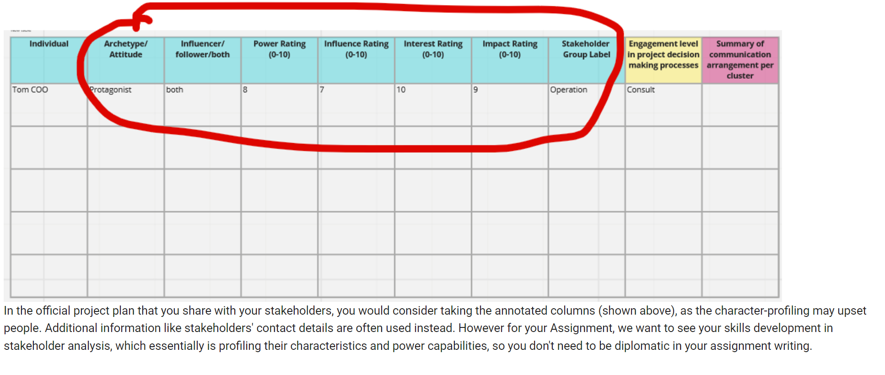
Step 2 - Clarifying the interest and influence of stakeholders (Character profiling of stakeholders)

Slide 12

Using the 3i’s to go deeper into stakeholder analysis
Interest:
Who is interested in your project and what is the nature of their interest, or who would you like to be interested (based on their influence and/or impact) who is currently disinterested, and why are they not interested?
Influence:
Who has the power to facilitate or block the generation of impacts from your project (indirectly)?
Impact:
Who is likely to benefit most from engaging with your project, and whose interests might be compromised or harmed as a result of your work?

Slide 13
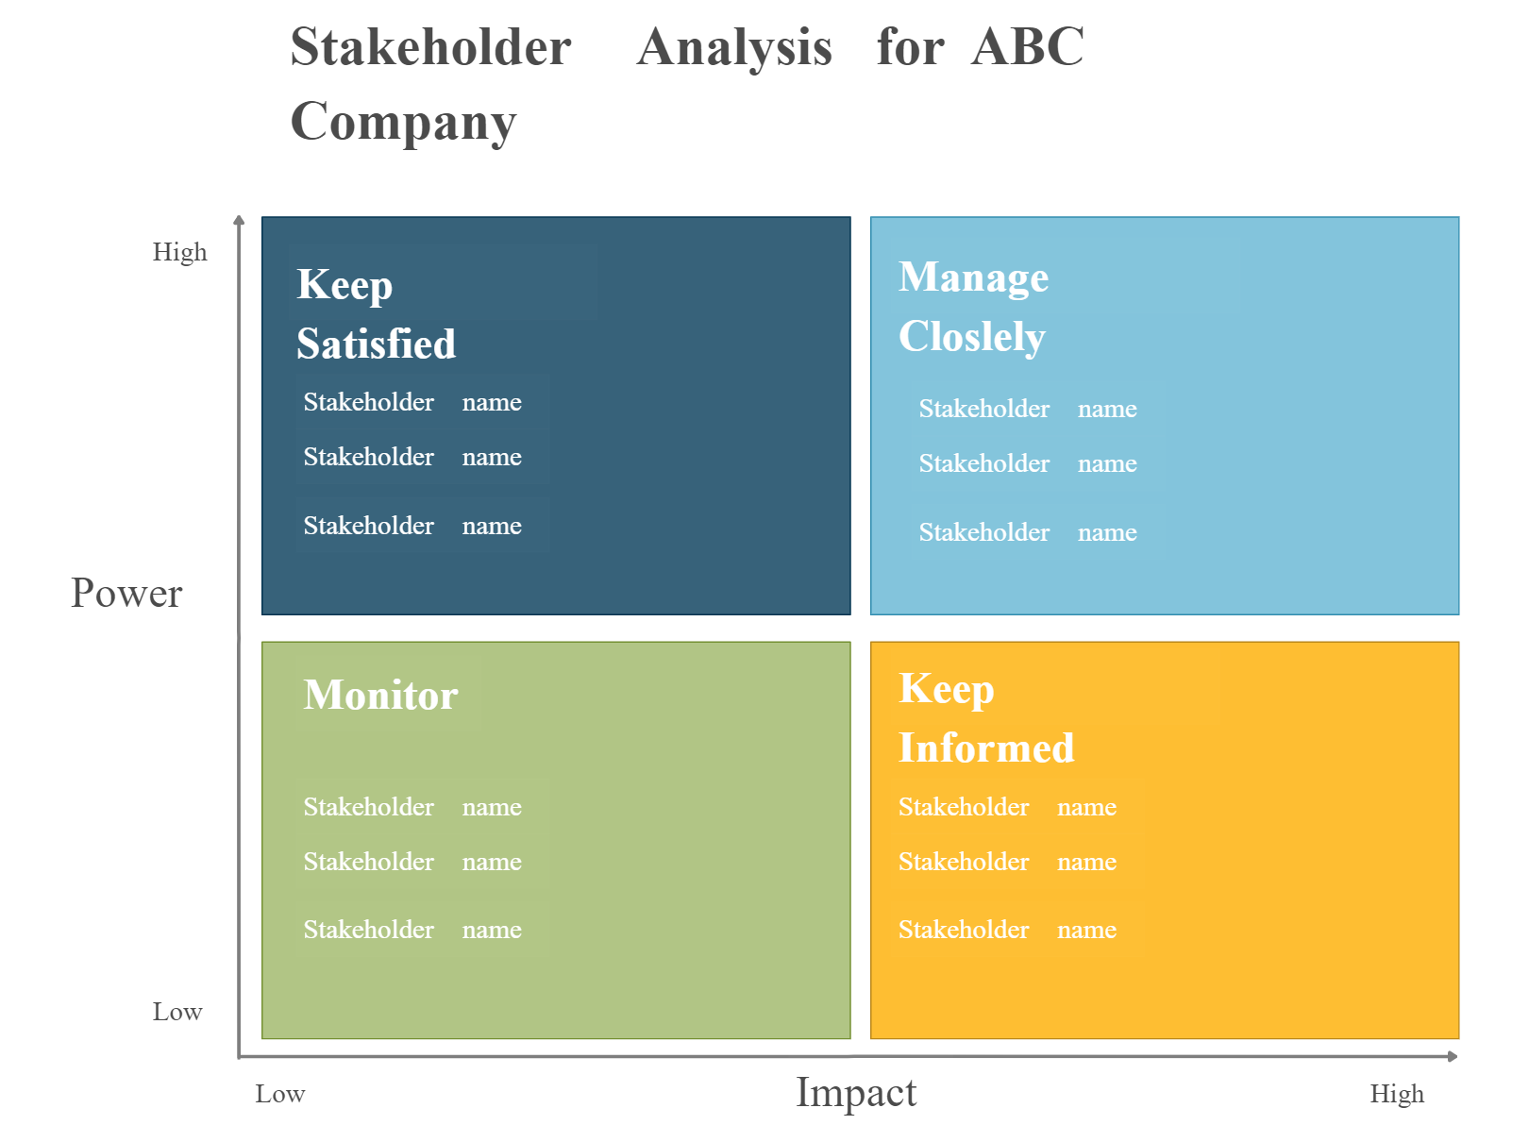
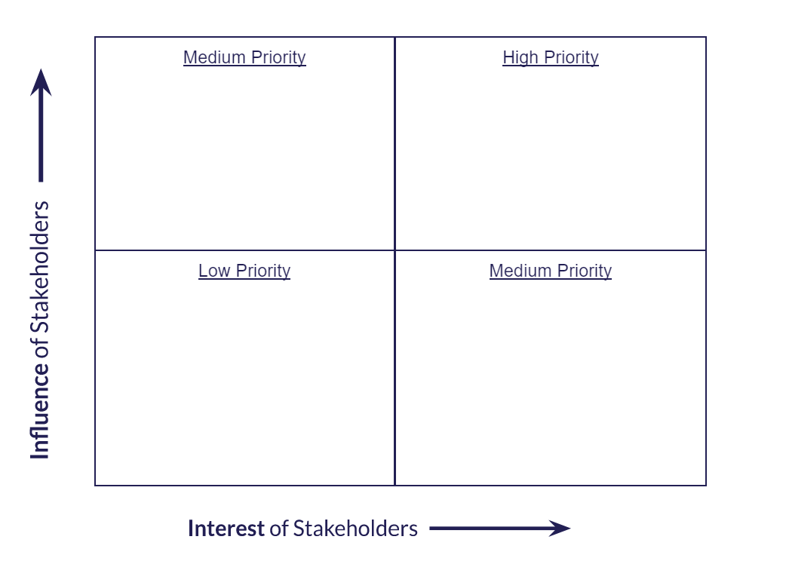
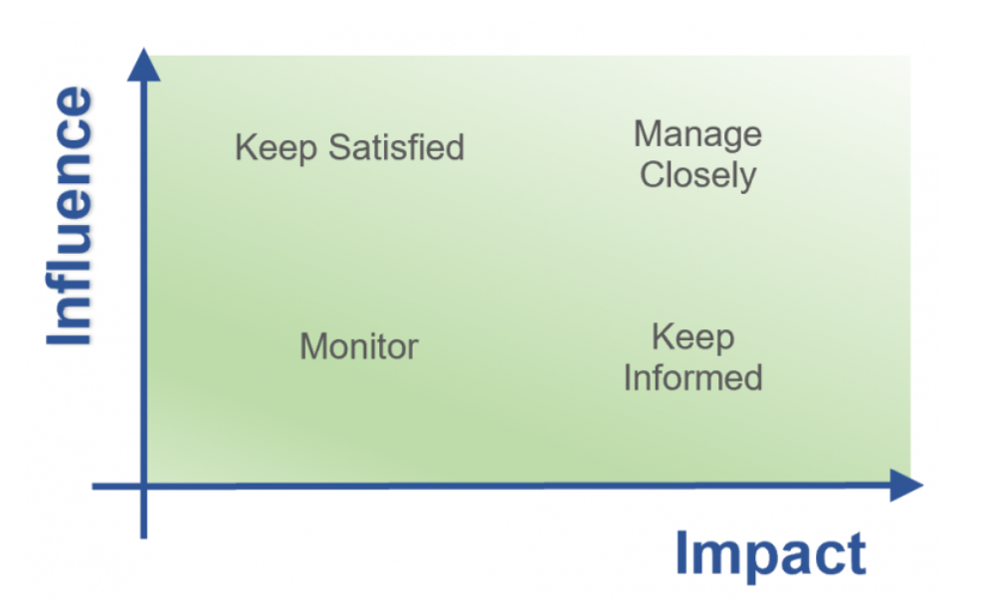

Slide 14
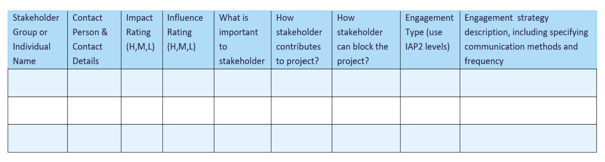
Step 3 – Agreeing on the on the process of engagement between stakeholders

Slide 15
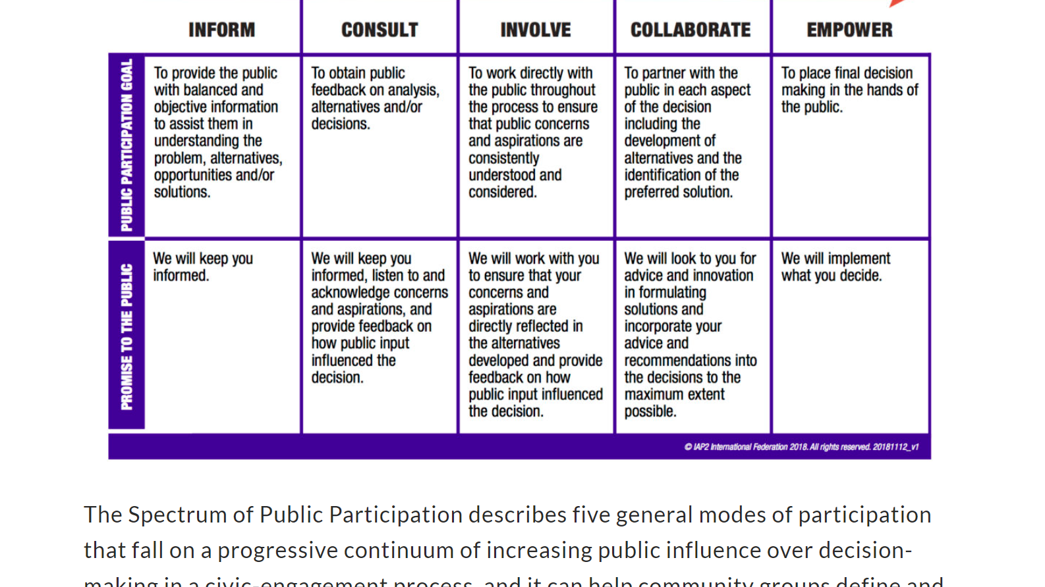
IAP2
Notes:
The Spectrum of Public Participation describes five general modes of participation that fall on a progressive continuum of increasing public influence over decision-making in a civic-engagement process, and it can help community groups define and determine the public’s role in a democratic decision-making process.
Due to its simplicity and descriptiveness, the Spectrum of Public Participation is particularly useful for those who are new to public-participation work.
Source: International Association for Public Participation (IAP2)
https://organizingengagement.org/models/spectrum-of-public-participation/

Slide 16
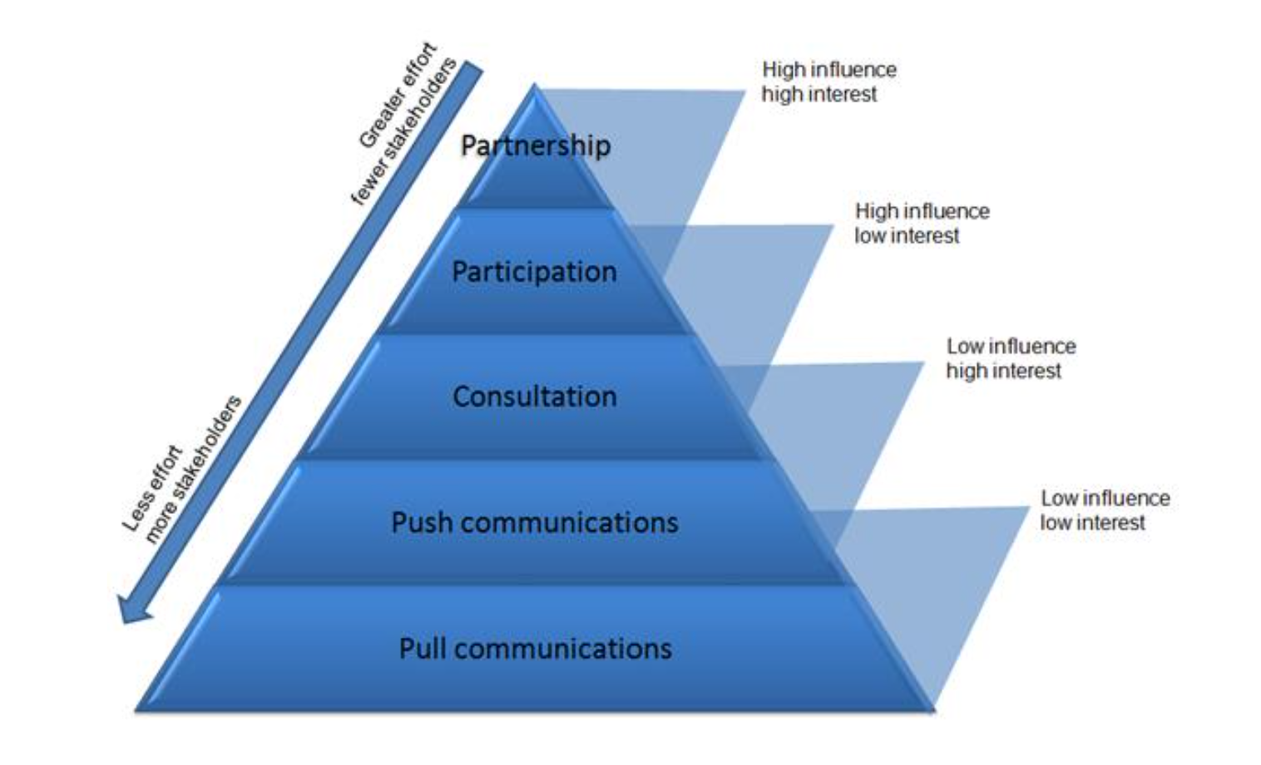
Stakeholder engagement model
Notes:
https://www.stakeholdermap.com/stakeholder-engagement.html#ment

Slide 17
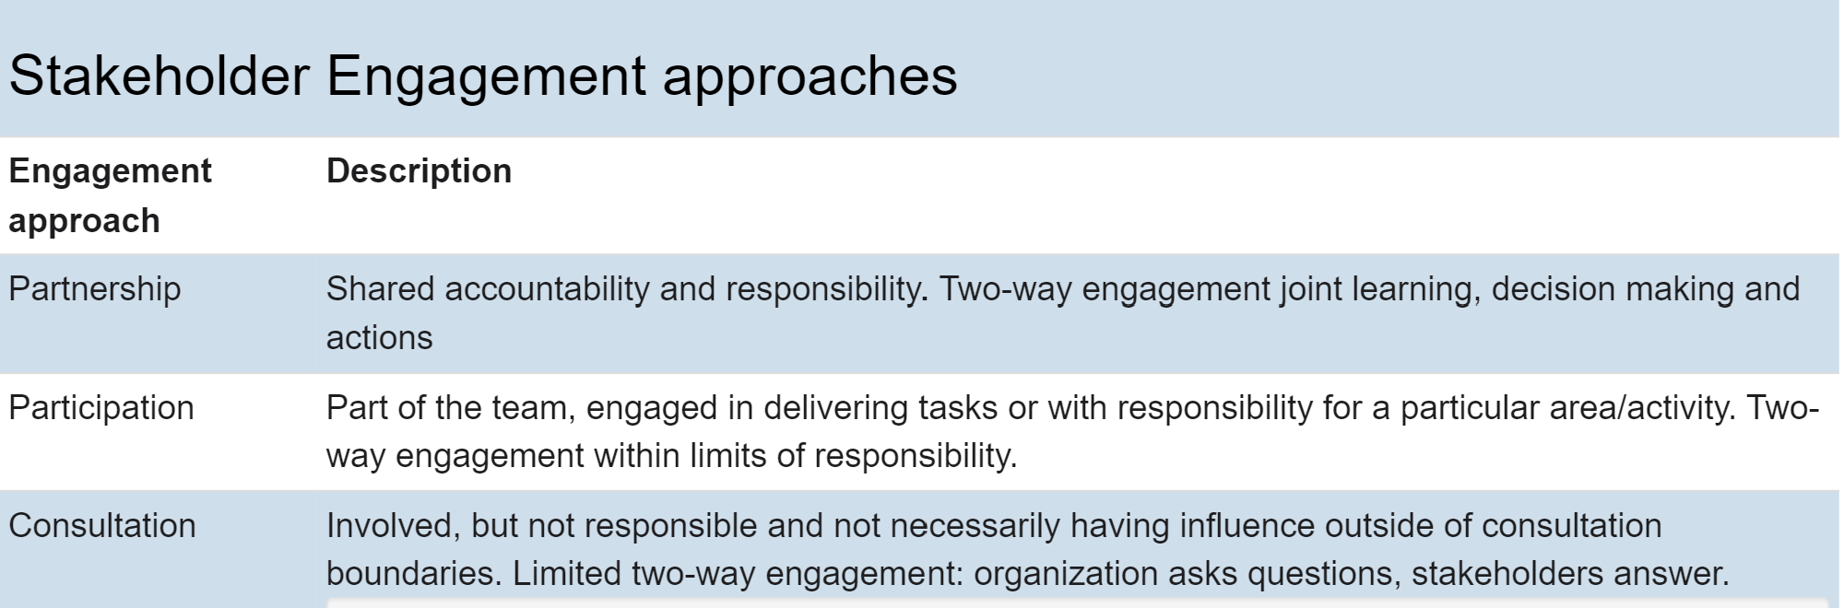
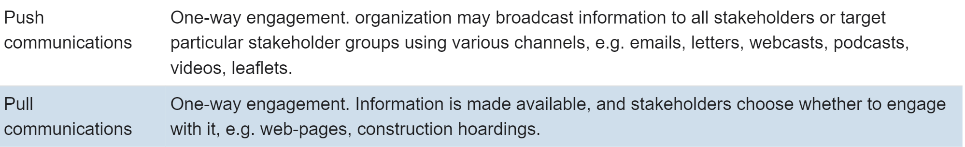
Stakeholder engagement approaches

Slide 18
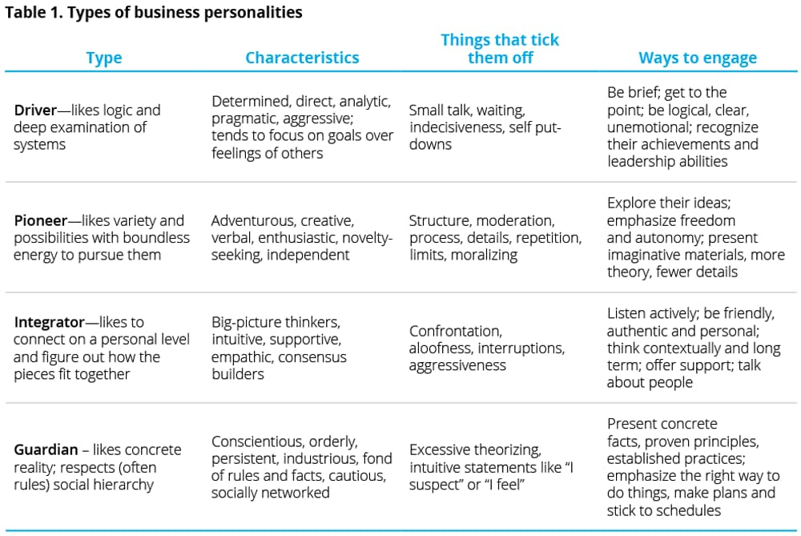
Step 4 - Managing the relationship with stakeholders.
Notes:
https://www2.deloitte.com/us/en/insights/focus/executive-transitions/managing-stakeholder-relationships.html
Does the project team have enough capacity to engage with the stakeholders?
Dr. Helen Fisher, a well-known author and research professor in the Department of Anthropology at Rutgers University, which we abbreviate in table 1.¹ This Business Chemistry typology focuses on effective interactions between its four key types.² A person could be more than one type—dominant in one and secondary and tertiary in others.

Slide 19

Stakeholder methodology Overview

Slide 20
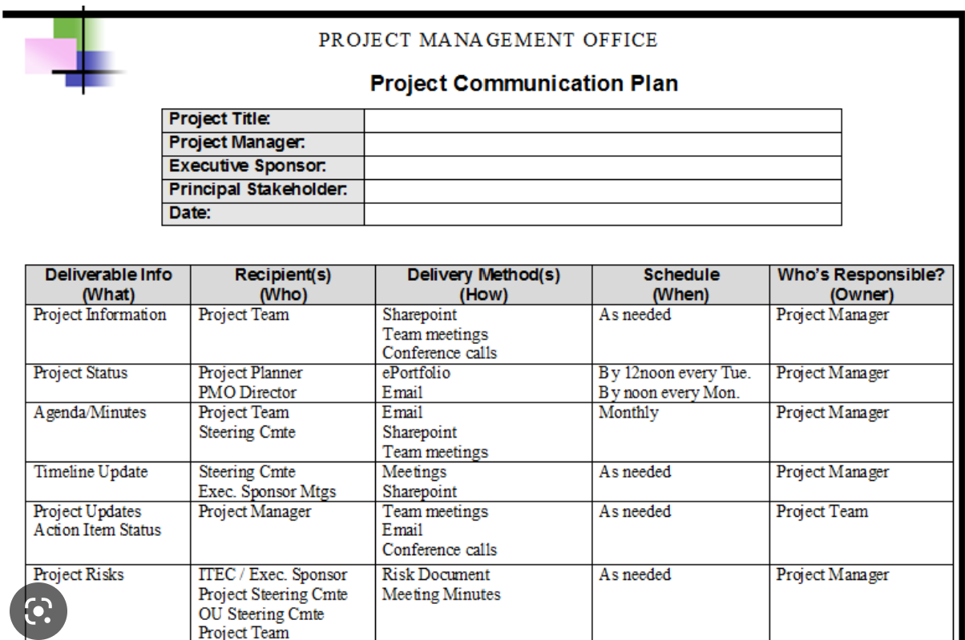

Slide 21
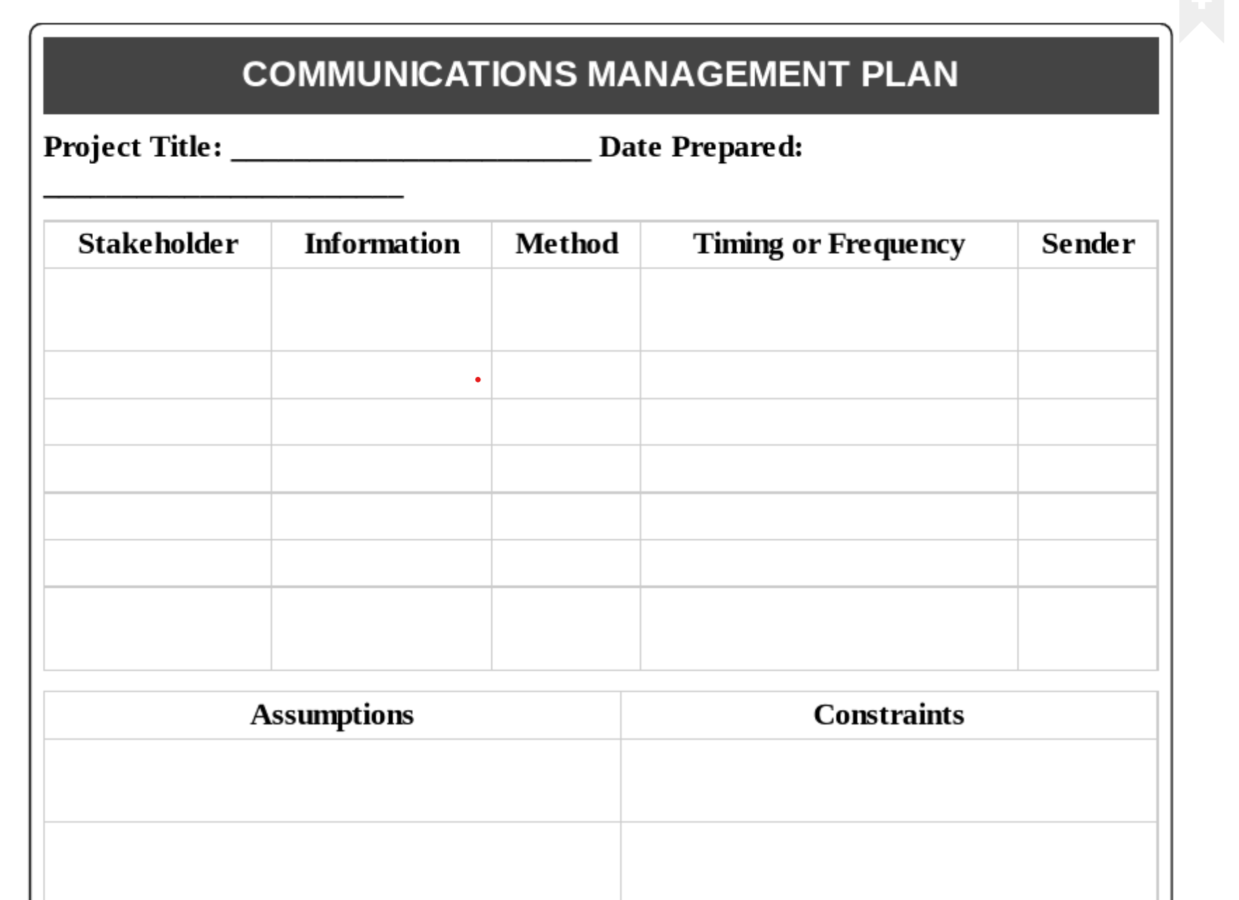

Slide 22
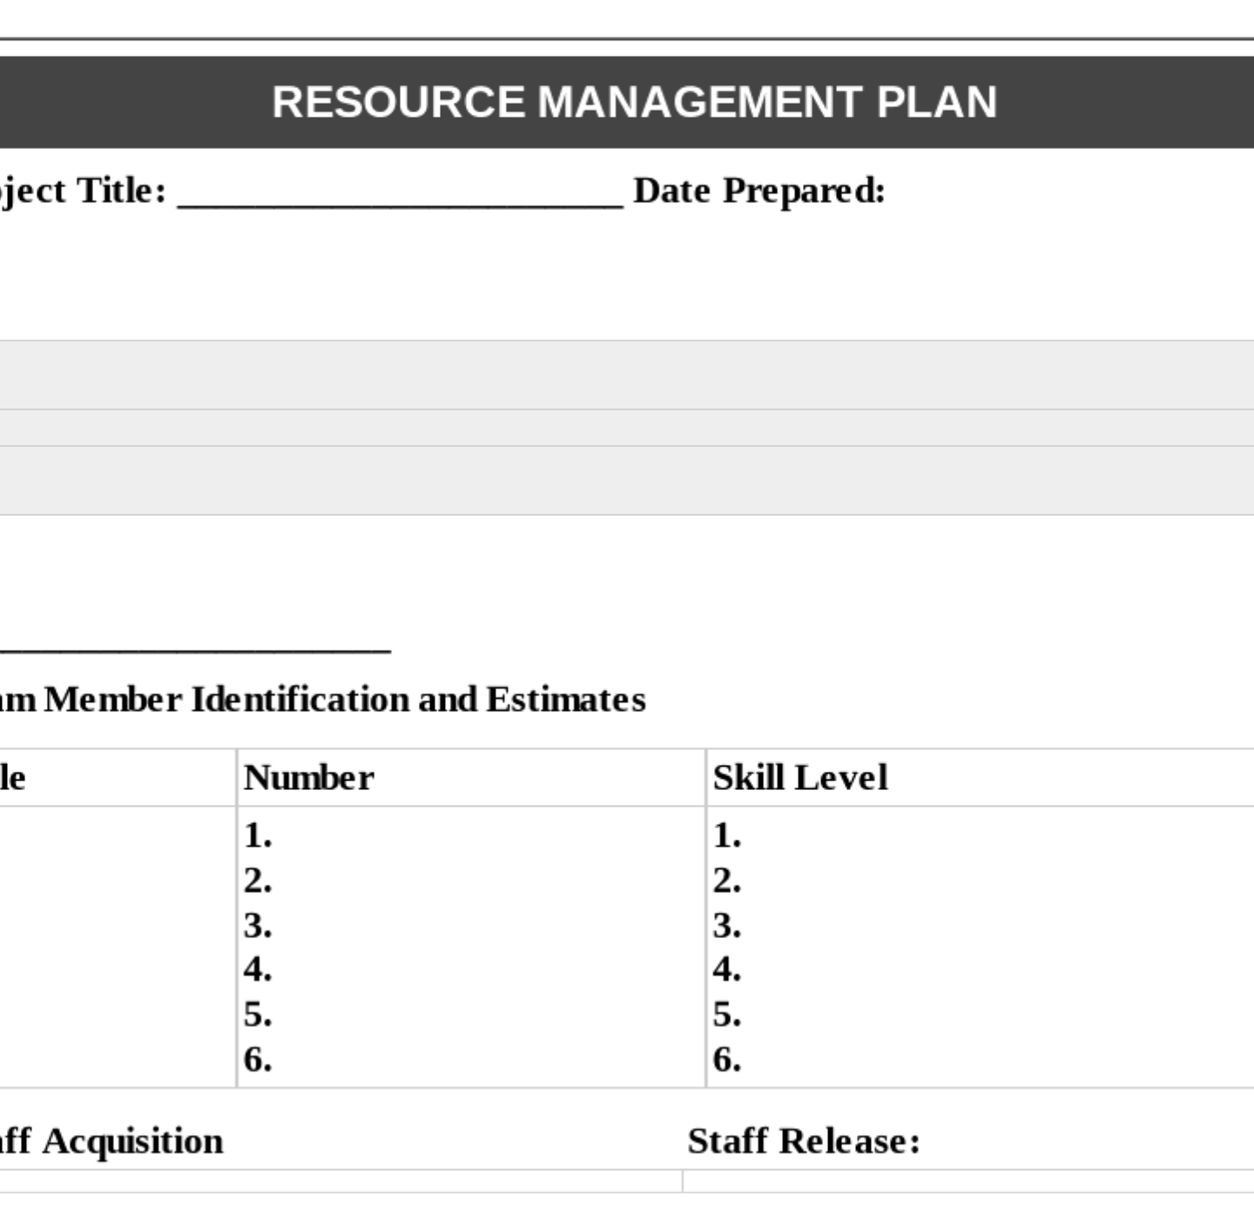
Resource management plan
Recruitment Plan
Training Plan

Slide 23

Conclusion
Consider “walking in the stakeholder’s shoes
Understanding how the business works.
Establishing good working relationships with peers.
Bring focused solutions not just problems.
Recruiting and managing a strong team. .
Know that what key stakeholders do not want is as important as, or more important than, knowing what they want.
Notes:
https://www2.deloitte.com/us/en/insights/focus/executive-transitions/managing-stakeholder-relationships.html

